Slide 1
Logistic Regression
Psy 524
Dr. Ainsworth
Psychology Department
California State University, Northridge

Slide 2
What is Logistic Regression?
Form of regression that allows the prediction of discrete variables by a mix of continuous and discrete predictors.
Addresses the same questions that discriminant function analysis and multiple regression do but with no distributional assumptions on the predictors (the predictors do not have to be normally distributed, linearly related or have equal variance in each group)

Slide 3
What is Logistic Regression?
Logistic regression is often used because the relationship between the DV (a discrete variable) and a predictor is non-linear
Example from the text: the probability of heart disease changes very little with a ten-point difference among people with low-blood pressure, but a ten point change can mean a drastic change in the probability of heart disease in people with high blood-pressure.

Slide 4
Questions
Can the categories be correctly predicted given a set of predictors?
Usually once this is established the predictors are manipulated to see if the equation can be simplified.
Can the solution generalize to predicting new cases?
Comparison of equation with predictors plus intercept to a model with just the intercept

Slide 5
Questions
What is the relative importance of each predictor?
How does each variable affect the outcome?
Does a predictor make the solution better or worse or have no effect?

Slide 6
Questions
Are there interactions among predictors?
Does adding interactions among predictors (continuous or categorical) improve the model?
Continuous predictors should be centered before interactions made in order to avoid multicollinearity.
Can parameters be accurately predicted?
How good is the model at classifying cases for which the outcome is known ?

Slide 7
Questions
What is the prediction equation in the presence of covariates?
Can prediction models be tested for relative fit to the data?
So called “goodness of fit” statistics
What is the strength of association between the outcome variable and a set of predictors?
Often in model comparison you want non-significant differences so strength of association is reported for even non-significant effects.

Slide 8
Assumptions
The only “real” limitation on logistic regression is that the outcome must be discrete.

Slide 9
Assumptions
If the distributional assumptions are met than discriminant function analysis may be more powerful, although it has been shown to overestimate the association using discrete predictors.
If the outcome is continuous then multiple regression is more powerful given that the assumptions are met

Slide 10
Assumptions
Ratio of cases to variables – using discrete variables requires that there are enough responses in every given category
If there are too many cells with no responses parameter estimates and standard errors will likely blow up
Also can make groups perfectly separable (e.g. multicollinear) which will make maximum likelihood estimation impossible.

Slide 11
Assumptions
Linearity in the logit – the regression equation should have a linear relationship with the logit form of the DV. There is no assumption about the predictors being linearly related to each other.

Slide 12
Assumptions
Absence of multicollinearity
No outliers
Independence of errors – assumes a between subjects design. There are other forms if the design is within subjects.

Slide 13
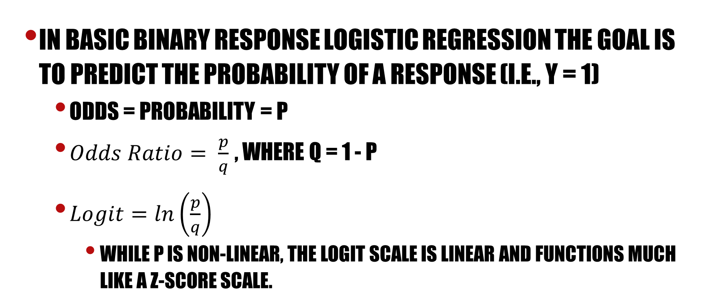
Background
In basic binary response logistic regression the goal is to predict the probability of a response (i.e., Y = 1)
Odds = probability = p
$Odds Ratio= \frac{p}{q}$, where q = 1 - p
$Logit=ln\left(\frac{p}{q}\right)$
While p is non-linear, the logit scale is linear and functions much like a z-score scale.
Notes:
Odds – like probability. Odds are usually written as “5 to 1 odds” which is equivalent to 1 out of five or .20 probability or 20% chance, etc.
The problem with probabilities is that they are non-linear
Going from .10 to .20 doubles the probability, but going from .80 to .90 barely increases the probability.
Odds ratio – the ratio of the odds over 1 – the odds. The probability of winning over the probability of losing. 5 to 1 odds equates to an odds ratio of .20/.80 = .25.
Logit – this is the natural log of an odds ratio; often called a log odds even though it really is a log odds ratio. The logit scale is linear and functions much like a z-score scale.

Slide 14
Conversions to Logit

Slide 15
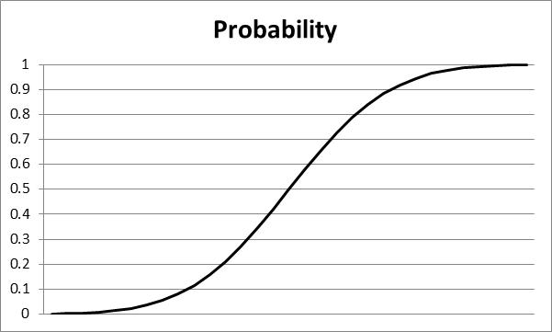
Conversions to Logit

Slide 16
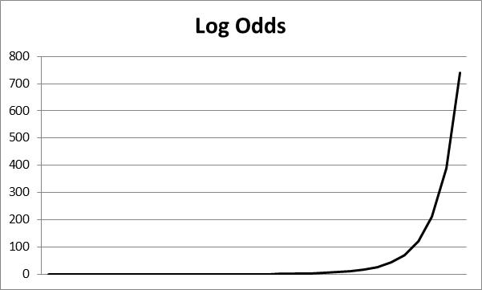
Conversions to Logit

Slide 17
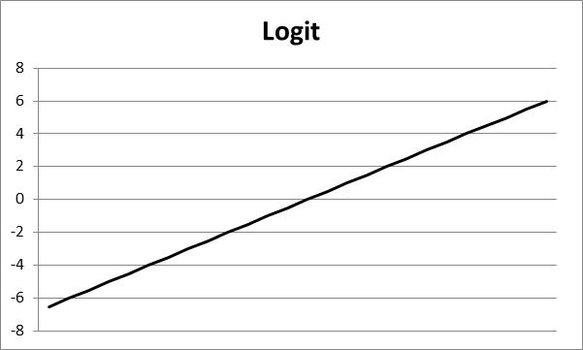
Conversions to Logit

Slide 18
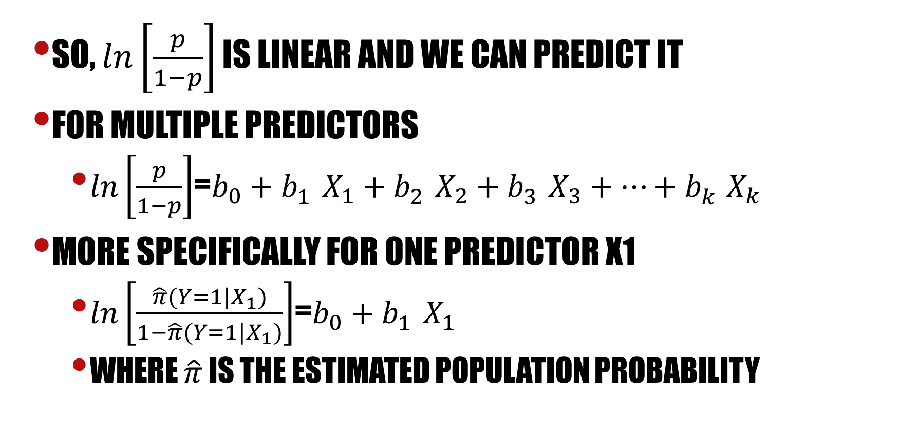
Background
So, $ln\left[\frac{p}{1−p}\right]$ is linear and we can predict it
For multiple predictors
$ln\left[\frac{p}{1−p}\right]$=$b_{0}+b_{1}^{}X_{1}+b_{2}^{}X_{2}+b_{3}^{}X_{3}+⋯+b_{k}^{}X_{k}$
More specifically for one predictor X1
$ln\left[\frac{\hat{π}(Y=1|X_{1})}{1−\hat{π}(Y=1|X_{1})}\right]$=$b_{0}+b_{1}^{}X_{1}$
Where $\hat{π}$ is the estimated population probability

Slide 19
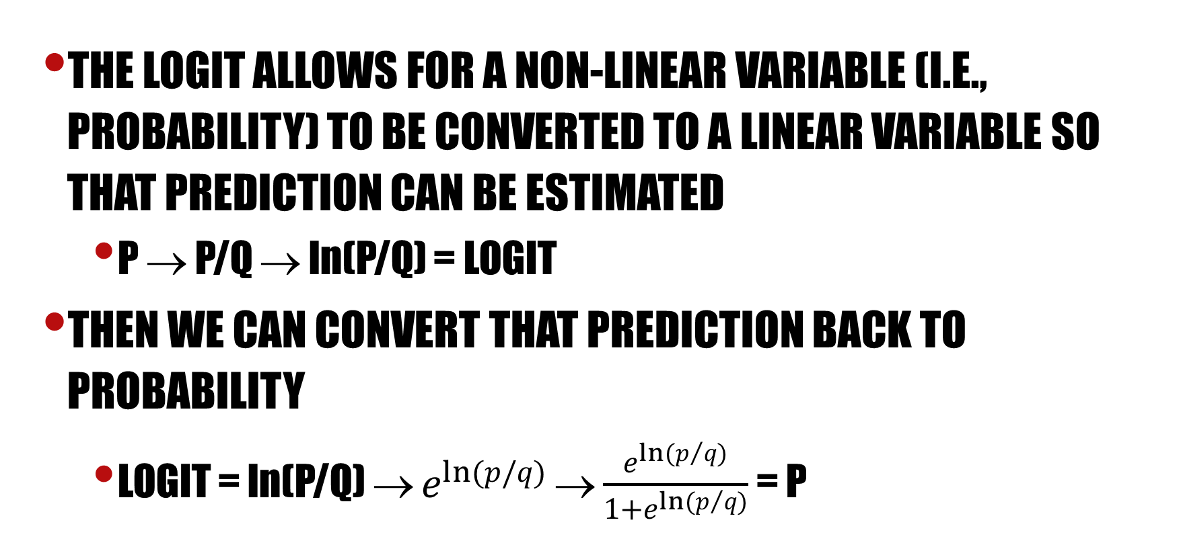
Background
The Logit allows for a non-linear variable (i.e., probability) to be converted to a linear variable so that prediction can be estimated
p → p/q → ln(p/q) = logit
Then we can convert that prediction back to probability
logit = ln(p/q) → $e^{ln(p/q)}$ → $\frac{e^{ln(p/{q)}}}{1+e^{ln(p/{q)}}}$ = p

Slide 20
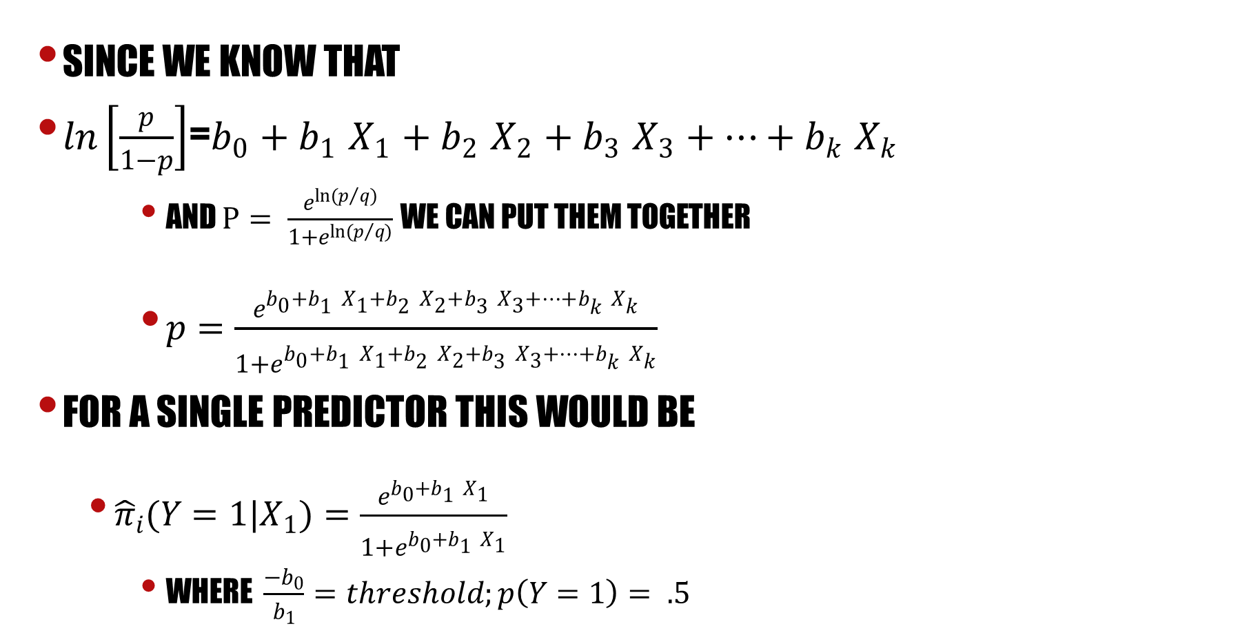
Background
Since we know that
$ln\left[\frac{p}{1−p}\right]$=$b_{0}+b_{1}^{}X_{1}+b_{2}^{}X_{2}+b_{3}^{}X_{3}+⋯+b_{k}^{}X_{k}$
and $p= \frac{e^{ln(p/{q)}}}{1+e^{ln(p/{q)}}}$we can put them together
$p=\frac{e^{b_{0}+b_{1}^{}X_{1}+b_{2}^{}X_{2}+b_{3}^{}X_{3}+⋯+b_{k}^{}X_{k}}}{1+e^{b_{0}+b_{1}^{}X_{1}+b_{2}^{}X_{2}+b_{3}^{}X_{3}+⋯+b_{k}^{}X_{k}}}$
For a single predictor this would be
${\hat{π}}_{i}(Y=1|X_{1})=\frac{e^{b_{0}+b_{1}^{}X_{1}}}{1+e^{b_{0}+b_{1}^{}X_{1}}}$
Where $\frac{−b_{0}}{b_{1}}=threshold;p\left(Y=1\right)= .5$

Slide 21
Plain old regression
Y = A BINARY RESPONSE (DV)
1 POSITIVE RESPONSE (Success) →P
0 NEGATIVE RESPONSE (failure) →Q = (1-P)
MEAN(Y) = P, observed proportion of successes
VAR(Y) = PQ, maximized when P = .50, variance depends on mean (P)
X_{j} = ANY TYPE OF PREDICTOR → Continuous, Dichotomous, Polytomous

Slide 22
Plain old regression
and it is assumed that errors are normally distributed, with mean=0 and constant variance (i.e., homogeneity of variance)

Slide 23
Plain old regression
an expected value is a mean, so
The predicted value equals the proportion of observations for which Y|X = 1; P is the probability of Y = 1(A SUCCESS) given X, and Q = 1- P (A FAILURE) given X.

Slide 24
Plain old regression
For any value of X, only two errors ( ) are possible, AND . Which occur at rates P|X AND Q|X and with variance (P|X)(Q|X)

Slide 25
Plain old regression
Every respondent is given a probability of success and failure which leads to every person having drastically different variances (because they depend on the mean in discrete cases) causing a violation of the homoskedasticity assumption.

Slide 26
Plain old regression
Long story short – you can’t use regular old regression when you have discrete outcomes because you don’t meet homoscedasticity (or independence of errors assumptions).

Slide 27
An alternative – the ogive function
An ogive function is a curved s-shaped function and the most common is the logistic function which looks like:

Slide 28
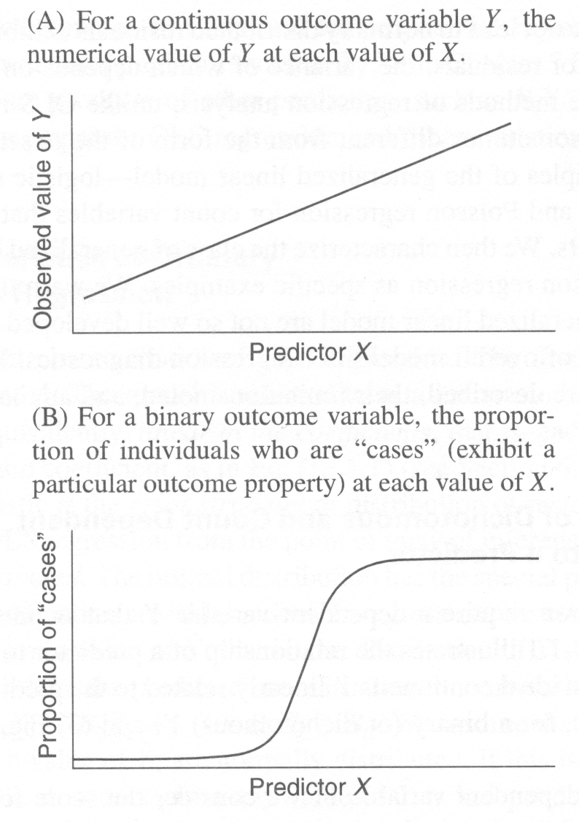
The logistic function

Slide 29
The logistic function
Where Y-hat is the estimated probability that the ith case is in a category and u is the regular linear regression equation:

Slide 30
The logistic function

Slide 31
The logistic function
Change in probability is not constant (linear) with constant changes in X
This means that the probability of a success (Y = 1) given the predictor variable (X) is a non-linear function, specifically a logistic function

Slide 32
The logistic function
It is not obvious how the regression coefficients for X are related to changes in the dependent variable (Y) when the model is written this way
Change in Y(in probability units)|X depends on value of X. Look at S-shaped function

Slide 33
The logistic function
The values in the regression equation b0 and b1 take on slightly different meanings.
b₀ ← The regression constant (moves curve left and right)
b₁ ← The regression slope (steepness of curve)
← The threshold, where probability of success = .50

Slide 34
Logistic Function
Constant regression constant, different slopes
v2: b0 = -4.00 b1 = 0.05 (middle)
v3: b0 = -4.00 b1 = 0.15 (top)
v4: b0 = -4.00 b1 = 0.025 (bottom)

Slide 35
Logistic Function
Constant slopes with different regression constants
v2: b0 = -3.00 b1 = 0.05 (top)
v3: b0 = -4.00 b1 = 0.05 (middle)
v4: b0 = -5.00 b1 = 0.05 (bottom)

Slide 36
The Logit
By algebraic manipulation, the logistic regression equation can be written in terms of an odds ratio for success:

Slide 37
The Logit
Odds ratios range from 0 to positive infinity
Odds ratio: P/Q is an odds ratio; less than 1 = less than .50 probability, greater than 1 means greater than .50 probability

Slide 38
The Logit
Finally, taking the natural log of both sides, we can write the equation in terms of logits (log-odds):
For a single predictor

Slide 39
The Logit
For multiple predictors

Slide 40
The Logit
Log-odds are a linear function of the predictors
The regression coefficients go back to their old interpretation (kind of)
The expected value of the logit (log-odds) when X = 0
Called a ‘logit difference’; The amount the logit (log-odds) changes, with a one unit change in X; the amount the logit changes in going from X to X + 1

Slide 41
More Logistic Regression
Psy 524
Dr. Andrew Ainsworth
Psychology Department
California state university, northridge

Slide 42
Equations
Logistic Regression Equation

Slide 43
Equations
The linear part of the logistic regression equation is used to find the probability of being in a category based on the combination of predictors
Programs like SPSS and SAS separate discrete predictors with more than two levels into multiple dichotomous variables.

Slide 44
Equations
Fall (0 = no, 1 = yes);
Difficulty is continuous;
season (1 = autumn, 2 = winter, 3 = spring)

Slide 45
Equations
Season is a discrete variable with three levels that would be turned into 2 separate variables season 1 and season 2.
Season 1 is coded 1 for autumn and 0 otherwise; season 2 is coded 1 if winter and 0 otherwise; spring is coded when both are 0.

Slide 47
Interpreting coefficients
Good news – regression coefficients and their standard errors are found through advanced calculus methods of maximum likelihood (e.g. derivatives, etc.), so we’re not getting into it in this applied course.

Slide 48
Interpreting coefficientss
Each coefficient is evaluated using a Wald test (really just a Chi Square test)

Slide 49
Interpreting coefficients
$$\hat{Y}=\frac{e^{−1.776+1.010\left(Diff\right)+.927\left(Ssn1\right)−.418(Ssn2)}}{1+e^{−1.776+1.010\left(Diff\right)+.927\left(Ssn1\right)−.418(Ssn2)}}$$

Slide 50
Interpreting coefficients
The tests of the coefficients are approximate Chi-square so they are tested as chi-squares. None of the coefficients are significant in the sample data.
The coefficients are placed into the model like in regular multiple regression in order to predict individual subjects’ probabilities.

Slide 51
Goodness of fit
Log-likelihood

Slide 52
Goodness of fit
Models are compared by taking 2 times the difference between the models log-likelihoods.
Note: models must be nested in order to be compared. Nested means that all components of the smaller model must be in the larger model.

Slide 53
Goodness of fit
Often a model with intercept and predictors is compared to an intercept only model to test whether the predictors add over and above the intercept only. This is usually noted as χ²=2[LL(B)-LL(0)]

Slide 56
Goodness of Fit
2[-8.740 - (-10.095)] = 2.74
the constant only model has one degree of freedom (for the constant) and the full model has 4 degrees of freedom (1 for the constant, and one for each predictor), the DF for the test is 4 – 1 = 3. The test of the chi-square is not significant at 3 DFs so the null is retained.
Models with different numbers of predictors (nested) can also be compared in the same fashion.

Slide 57
Standardized Residuals
Given a model you can calculate the standardized residual of each persons predicted probability (using the rather scary matrix formula on pg. 450 in t&F)
You can have SPSS save the standardized residuals and once this is done you can analyze them to see if any are above 3.3 and if they are the subject is an outlier according to the given model.

Slide 58
Types of Logistic Regression
Direct or Simultaneous
Sequential or User defined
Stepwise or Statistical
Probit vs. Logistic
Logistic assumes a categorical (qualitative) underlying distribution
Probit assumes a normal distribution and uses Z-scores to estimate the proportion under the curve.
Near .5 the analyses are similar they only differ at the extremes.

Slide 59
Inferential Tests
Assessing goodness of fit for the model
There are many goodness of fit indices, so you need to keep in mind what is being compared to know whether a significant difference is good or not. Some tests significance means fit and others significance means lack of fit.

Slide 60
Inferential Tests
Also consider sample sized when evaluating goodness of fit. Chi-square statistics are heavily influenced by sample size so that with a very large sample even minute differences will be significant.
If the sample size is large and the chi-square is significant this may not be important
Though if there is significance and the sample is relatively small than the effect is notable.

Slide 61
Inferential Tests
Constant only vs. full model – here you want there to be a significant improvement to the prediction when all of the predictors are added to the model.
Perfect model vs. proposed model – some programs test the proposed model against a perfect model (one that predicts perfectly) in this case you want the chi-square to be non-significant.

Slide 62
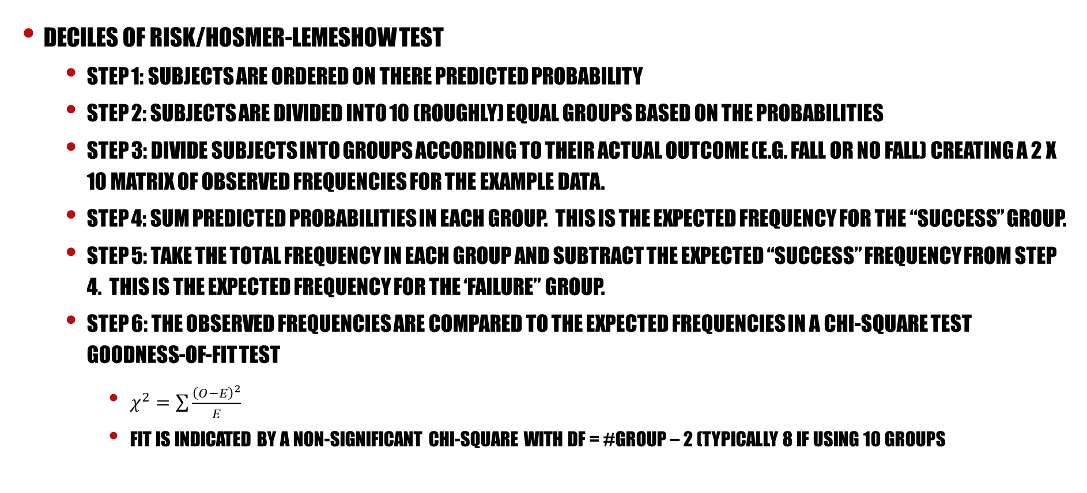
Inferential Tests
Deciles of risk/Hosmer-Lemeshow test
Step 1: Subjects are ordered on there predicted probability
Step 2: Subjects are divided into 10 (roughly) equal groups based on the probabilities
Step 3: Divide subjects into groups according to their actual outcome (e.g. fall or no fall) creating a 2 X 10 matrix of observed frequencies for the example data.
Step 4: Sum Predicted Probabilities in each group. This is the expected frequency for the “success” group.
Step 5: take the total frequency in each group and subtract the expected “success” frequency from step 4. this is the expected frequency for the ‘failure” group.
Step 6: the observed frequencies are compared to the expected frequencies in a chi-square test goodness-of-fit test
$χ^{2}=\sum{\frac{{\left(O−E\right)}^{2}}{E}}$
Fit is indicated by a non-significant chi-square with df = #group – 2 (typically 8 if using 10 groups

Slide 63
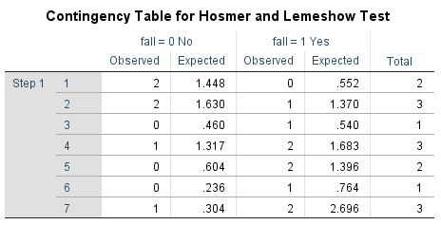
Inferential Tests
spss
H-L test used only 7 groups because only 15 respondents
The fall = Yes expected is simply the sum of the predicted probability
Fall = no expected frequency is computed as total – fall = Yes expected frequency

Slide 64
Test of individual predictors
The Wald test is usually used to assess the significance of prediction of each predictor
The Wald test is known to be overly conservative (increased type II error) and when a predictor is multinomial it does not give a test of the whole predictor but only the dummy coded versions of the predictor.

Slide 65
Number and type of outcomes
Logistic regression with more than two outcome categories
If the response are ordered polytomous than k – 1 equations are made (k being the number of categories) which predicts the probability that a case is above a given category.
Defines thresholds – point in the data that separates category one form two, two from three, etc.
Calculates the probability that a person passes a given threshold
This is done for all categories except the last because the probability of being in a category above the highest is zero.

Slide 66
Number and type of outcomes
If the responses are non-ordered multinomial than again k – 1 equations are created but the equations are predicting whether a person belongs to a category or not. An equation is made for all categories except the last.
SPSS ordinal (plum) is used for ordered polytomous and SPSS multinomial (nomreg) is used for un-ordered multinomial data.

Slide 67
Strength of association (pseudo R-square)
There are several measures intended to mimic the R-squared analysis, but none of them are an R-squared. The interpretation is not the same, but they can be interpreted as an approximate variance in the outcome accounted for by the

Slide 68
Strength of association (pseudo R-square)
McFadden’s
this value tends to be smaller than R-square and values of .2 to .4 are considered highly satisfactory.

Slide 69
Strength of association (pseudo R-square)
Cox and Snell is also based on log-likelihood but it takes the sample size into account:
but it cannot reach a maximum of 1 like we would like so…

Slide 70
Strength of association (pseudo R-square)
The Nagelkerke measure adjusts the C and S measure for the maximum value so that 1 can be achieved:

